Slide 1
Finding the best suburb in Brisbane for a new business

Slide 2
Introduction
Brisbane is the capital of the Australian state of Queensland
Population is over 2.5 million
The city is divided into 6 settlements:
  Inner suburbs
  Northern suburbs
  Southern suburbs
  Eastern suburbs
  Western suburbs
  Moreton Bay

Slide 3
Introduction
There are a total of 197 suburbs in Brisbane
Each suburb has several well established businesses
We will try to find what type of businesses are already established in each suburb, in order to find out what new business might be most successful

Slide 4
Business Problem
More and more people are moving to Brisbane from more expensive cities such as Sydney and Melbourne, so the city is growing due to this migration. For someone who is looking to move to Brisbane (or has already moved here, like we have), and is looking to start a new local business venture, it may be difficult to know what type of business would be most likely to succeed.
While there are many already established businesses in Brisbane, there are many that don’t exist in all suburbs, even though there might be a demand for products or services of that business. This report attempts to provide guidance as to what type of business might be suitable in certain suburbs of Brisbane.
Target Audience: Anyone who is looking to start a new business in any of the suburbs of Brisbane, Australia.

Slide 5
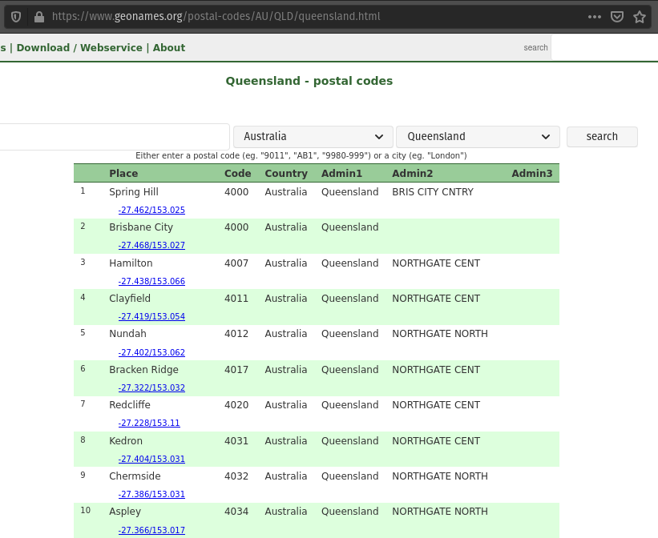
Data
First set of data was scraped from this website:

Slide 6
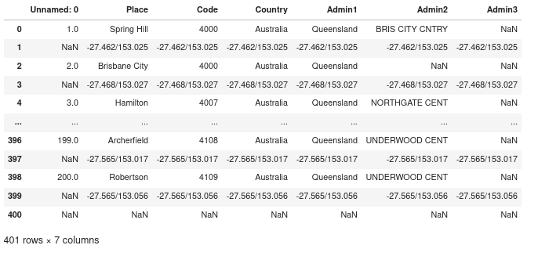
Data
It was cleaned and formatted into the following dataframe:

Slide 7
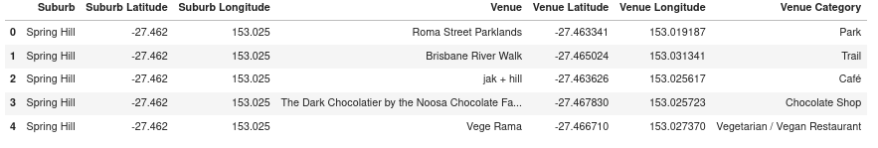
Data
The second set of data was retrieved from Foursquare API, and converted from a JSON file into a Pandas dataframe:

Slide 8
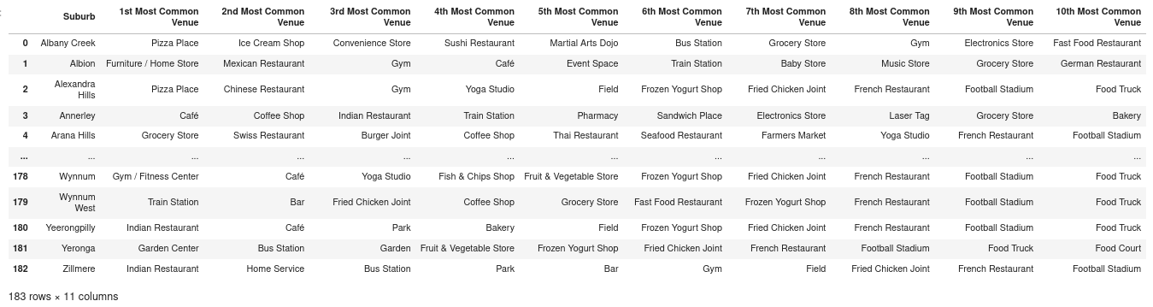
Methodology
Using Exploratory Data Analysis, we find the most frequent venue types in each suburb:

Slide 9
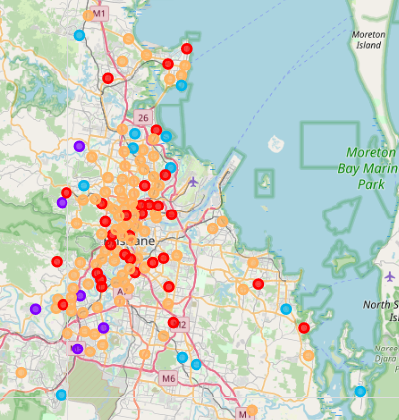
Methodology
We found that the venues in Brisbane suburbs can be clustered into 5 separate clusters:
1. Cafes/Coffee shops and restaurants
2. Public transport venues
3. Parks, Playgrounds, Stores
4. Sport venues
5. Family oriented venues

Slide 10
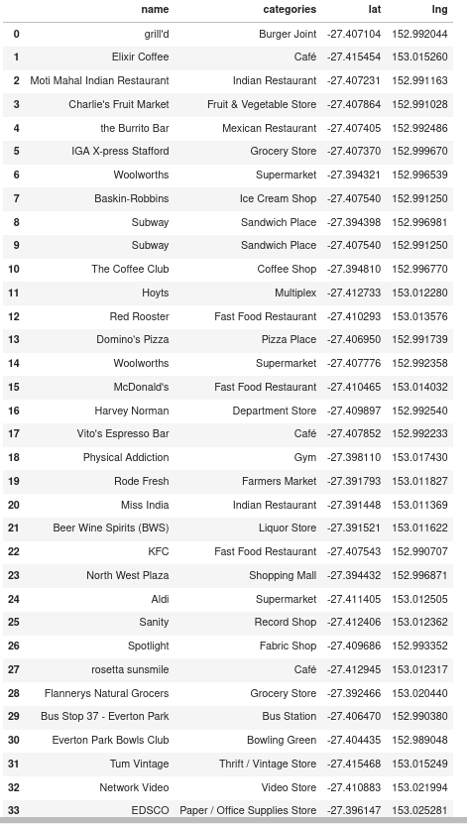
Results
Exploring a specific suburb (Everton Park), we find that there is only 1 (Asian food) restaurant in the suburb, but several fast food and family oriented restaurants within a radius of 2 km.

Slide 11
Discussion of Results
As can be seen in the above list of venues within 2 km of the restaurant in Everton Park, there are 36 venues returned by FourSquare. While there are several fast food restaurants, and a number of Cafes/coffee shops and Indian restaurants, there are no Thai food restaurants or Italian food restaurants (not counting Domino's Pizza as Italian).
Therefore, an entrepreneur looking to start a new restaurant in the area might look at starting a new Thai food or Italian food restaurant, as the area currently doesn't have either of those restaurants.

Slide 12
Observations
We found that the venues in the suburbs of Brisbane could be grouped into 5 different clusters, namely:
1. Cafes/Coffee shops and restaurants
2. Public transport venues
3. Parks, Playgrounds, Stores
4. Sport venues
5. Family oriented venues
We also found that in Everton Park, there are several fastfood restaurants, as well as cafes and Indian restaurants, there are no Thai food or Italian restaurants, so starting a new Thai food or Italian restaurant might be something worth while investigating further.

Slide 13
Conclusion
In conclusion, we found that the venues in the suburbs of Brisbane could be grouped into 5 different clusters, namely:
1. Cafes/Coffee shops and restaurants
2. Public transport venues
3. Parks, Playgrounds, Stores
4. Sport venues
5. Family oriented venues
Furthermore, we found that in Everton Park, there are several fast food restaurants, as well as cafes and Indian restaurants, there are no Thai food or Italian restaurants, so starting a new Thai food or Italian restaurant might be something worth while investigating further.

Slide 14
Recommendations
For anyone looking to open a cafe or coffee shop, they might want to look at suburbs outside of the first cluster, as these suburbs already have plenty of coffee shops.
Furthermore, anyone looking to start a new restaurant in the Everton Park suburb, it’s recommended to look at restaurants that are currently not present within a reasonable radius (such as 2 km), such as a Thai Food restaurant or an Italian Food restaurant.

